Slide 1
Waves and Sound
High School Physics
Unit 10
Notes:
NAD 2023 Standard ER3 (Properties of Waves)

Slide 2
Credits
This Slideshow was developed to accompany the textbook
OpenStax High School Physics
Available for free at https://openstax.org/details/books/physics
By Paul Peter Urone and Roger Hinrichs
2020 edition
Some examples and diagrams are taken from the OpenStax College Physics, Physics, and Cutnell & Johnson Physics 6th ed.
Slides created by
Richard Wright, Andrews Academy
rwright@andrews.edu

Slide 3
10-01 Waves
In this lesson you will…
Describe the types of waves.
Use properties of waves.
Notes:
OpenStax High School Physics 13.1, 2
OpenStax College Physics 2e 16.9, 16.2

Slide 4
10-01 Waves
Waves
A traveling disturbance
Carries energy from place to place
When a boat makes a wave,
the water itself does not get up and move
the water pushes a little, then moves back
energy is transferred in the wave and is what you feel
Notes:
If the water moved in bulk, then there would be a hole in the water.

Slide 5
10-01 Waves
Transverse
Up and down disturbance
Wave travels left or right
Disturbance is perpendicular to direction of travel
Examples:
Radio waves, light waves, microwaves, stringed instruments
Notes:
Demonstrate with a slinky

Slide 6
10-01 Waves
Longitudinal Waves
Disturbance is left and right
Direction of travel is left or right
Disturbance and direction of travel are parallel
Series of compressed and stretched regions
Example:
Sound
Notes:
Demonstrate with a slinky

Slide 7
10-01 Waves
Other
Water waves are a combination
Water at the surface of a water wave travels in small circles

Slide 8
10-01 Waves
Periodic → pattern is regularly repeated
Cycle → one unit of pattern
Wavelength (λ) → Distance of one cycle
Amplitude (A) → height from equilibrium to crest
Notes:
Put drawing on board and label the parts
The amplitude of a longitudinal wave is the amount of compression instead of a height

Slide 9
10-01 Waves
Period (T) → time it takes for one cycle
Unit: s
Frequency (f) → # of cycles per second
Unit: 1/s = 1 hertz (Hz)
$f=\frac{1}{T}$
$v=\frac{λ}{T}=f⋅λ$

Slide 10
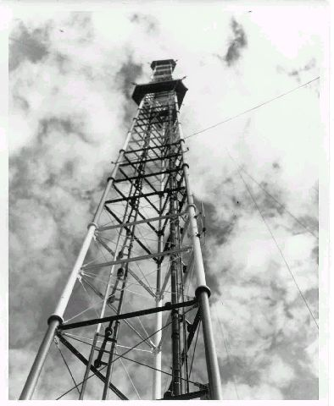
10-01 Waves
WAUS operates at a frequency of 90.7 MHz. These waves travel at $2.99×{10}^{8}$ m/s. What is the wavelength and period of these radio waves?
λ = 3.30 m
T = $1.10×{10}^{−8}$ s
Notes:
$$v = f$$
$$2.99×{10}^{8}\frac{m}{s}=90.7×{10}^{6} Hz $$
$$=3.30 m$$
$$f=\frac{1}{T} → 90.7×{10}^{6} Hz=\frac{1}{T} → T=\frac{1}{90.7×{10}^{6} Hz}=1.10×{10}^{−8} s$$

Slide 11
10-01 Waves
You are sitting on the beach and notice that a gull floating on the water moves up and down 15 times in 1 minute. What is the frequency of the water waves?
f = 0.25 Hz
Notes:
$$Frequency is\frac{cycles}{seconds}$$
$$f=\frac{15}{60 s}=0.25 Hz$$

Slide 12
10-01 Homework
Wave hello to some exercises.
Read
OpenStax College Physics 2e 16.10
OR
OpenStax High School Physics 13.3

Slide 13
10-02 Superposition and Interference
In this lesson you will…
Understand wave interference and superposition.
Use beats.
Notes:
OpenStax High School Physics 13.3
OpenStax College Physics 2e 16.10

Slide 14
10-02 Superposition and Interference
Often two or more wave pulses move through the same space at once
When two or more waves are present simultaneously at the same place, the resultant disturbance is the sum of the disturbances from individual waves

Slide 15
10-02 Superposition and Interference
Notes:
Try to demonstrate with spring or wave tank

Slide 16
10-02 Superposition and Interference
After 2 seconds, what is the height of the resultant pulse at x = 2, 4, and 6 cm?
Notes:
Draw the result on the pull down graph
0, -2, 2

Slide 17
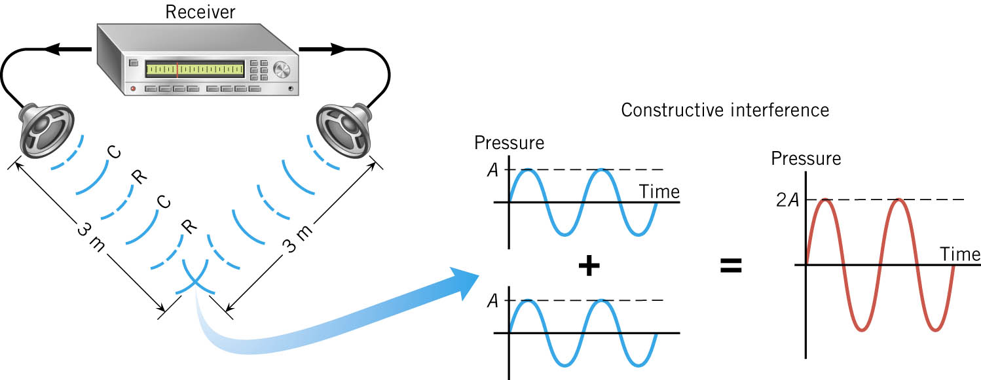
10-02 Superposition and Interference
Imagine that there are 2 speakers facing each other. Both speakers produce the same sound at the same time. λ = 1 m
Notes:
At a point between the speakers where each of the sounds have moved full wavelengths
Condensation meats condensation and rarefaction meets rarefaction all the time
Linear superposition says the sound louder
Called constructive interference (exactly in phase)

Slide 18
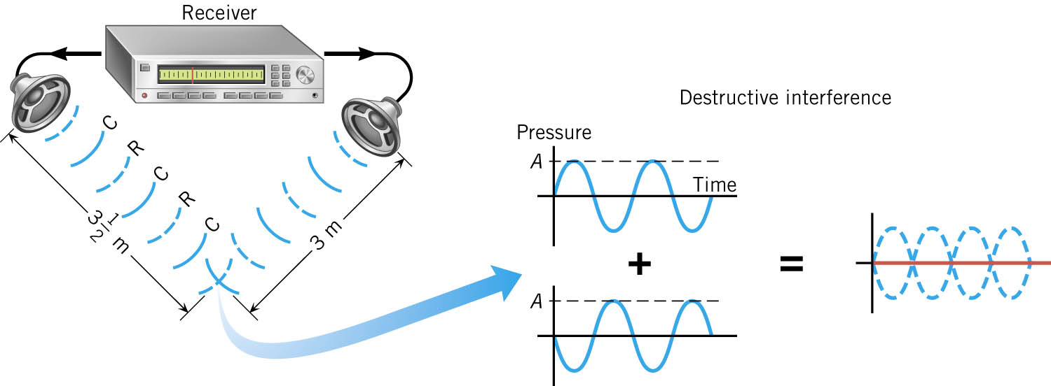
10-02 Superposition and Interference
One of the speakers is moved back half a wavelength
Notes:
Now a condensation always meets a rarefaction, so cancel into nothing
Called Destructive interference (exactly out of phase)

Slide 19
07-06 Superposition and Interference

Slide 20
10-02 Superposition and Interference
Notes:
A microphone hears the noise
The electronics invert the noise
A speaker plays the inverted noise and destructive interference results so you don’t hear much

Slide 21
10-02 Superposition and Interference
Notes:
Solid lines are condensations, dashed lines are rarefactions
2 fixed speakers
where two condensations or rarefactions meet = constructive interference (red dots)
Where a condensation and rarefaction meet = destructive interference (white dots)
So as you move throughout the room the noise intensities change depending on your position
Follows law of conservation of energy
At constructive interference → twice as much energy
At destructive interference → no energy
Add it all up and you get constant energy (1 + 1 = 2 + 0)

Slide 22
10-02 Superposition and Interference
Beats
When two frequencies are the same
Constructive and Destructive Interference give twice the amplitude or no amplitude
What if the two frequencies are just slightly different?

Slide 23
10-02 Superposition and Interference
Notes:
When the frequencies are slightly different, Constructive and destructive interference still happens
Where two condensations are at the same place, you get louder
Where 1 condensation and 1 rarefaction are at the same place, you get softer
You get some places with loud and some soft and in between

Slide 24
10-02 Superposition and Interference
Notes:
What the ear hears is the rising and falling of volume of the combined frequency
How often the loudness rises and falls is the beat frequency
Beat frequency obtained from subtracting the two frequencies of the sounds.
In the picture, the number above each blue wave indicates the number of complete cycles
The top wave is 10 Hz, the bottom is 12 Hz
The beat frequency is 12 – 10 = 2 Hz as seen in the red wave

Slide 25
10-02 Superposition and Interference
Beat Frequency = difference of the two source frequencies
Beats = | f₁ – f₂ |

Slide 26
10-02 Superposition and Interference
A simple way to tune musical instruments is with beats
If the notes are out of tune, you hear beats
Adjust the tuning and try again
If the frequency of the beats is higher, adjust the other way
Keep adjusting until there are no more beats

Slide 27
10-02 Superposition and Interference
Two car horns have an average frequency of 420 Hz and a beat frequency of 40 Hz. What are the frequencies of both horns?
440 Hz, 400 Hz
Notes:
$$f_{ave}=\frac{f_{1}+f_{2}}{2}$$
$$f_{B}=f_{1}−f_{2}$$
$$420 Hz=\frac{f_{1}+f_{2}}{2}$$
$$40 Hz=f_{1}−f_{2}$$
$$840 Hz=f_{1}+f_{2}$$
$$40 Hz=f_{1}−f_{2}$$
$$880 Hz=2f_{1}$$
$$f_{1}=440 Hz$$
$$f_{2}=400 Hz$$

Slide 28
10-02 Superposition and Interference
Standing Waves
Waves that don’t appear to move
Formed by the superposition of two waves moving in opposite directions
If the waves have the same amplitude and wavelength, then they alternate between constructive and destructive interference

Slide 29
10-02 Superposition and Interference
How Standing Waves are Created
The wave travels along the string until it hits the other end
The wave reflects off the other end and travels in the opposite direction, but upside down
The returning wave hits the vibrating end and reflects again (this side the wave is right side up)
If the timing is just right the reflecting wave and the new wave will coincide

Slide 30
10-02 Superposition and Interference
One end of a string is attached to a fixed point.
The other end is vibrated up and down.
The standing wave is formed.
Nodes – No move
Antinodes – most movement

Slide 31
10-02 Homework
Don’t beat around the bush, start the problems now!
Read
OpenStax College Physics 2e 17.1-17.2
OR
OpenStax High School Physics 14.1, 2

Slide 32
10-03 Sound
In this lesson you will…
Understand how sound is created.
Understand how human perceive the properties of sound waves.
Notes:
OpenStax High School Physics 14.1, 2
OpenStax College Physics 2e 17.1-17.2

Slide 33
10-03 Sound
How sound is made
Some vibrating object like a speaker moves and compresses the air
Air pressure rises called Condensation
Condensation moves away at speed of sound
Object moves back creating less air pressure called Rarefaction
Rarefaction moves away at speed of sound
Particles move back and forth
Notes:
Maybe have big speaker with bouncing something on it

Slide 34
10-03 Sound
Distance between consecutive condensations or rarefactions is wavelength
String or speaker makes air molecule vibrate
That molecule pushes the next one to vibrate and so on
When it hits the ear, the vibrations are interpreted as sound

Slide 35
10-03 Sound
1 cycle = 1 condensation + 1 rarefaction
Frequency = cycles / second
1000 Hz = 1000 cycles / second
Each frequency has own tone
Sounds with 1 frequency called Pure Tone
Healthy young people can hear frequencies of 20 to 20,000 Hz

Slide 36
10-03 Sound
Brain can interpret frequency as pitch
High freq = high pitch
Subjective because most people don’t have perfect pitch
Some electronic devices can produce and detect exact frequencies

Slide 37
10-03 Sound
The condensations have more pressure than the rarefactions
Amplitude = highest pressure
Typical conversation, Amp = 0.03 Pa
Atmospheric air pressure = 101,000 Pa
Loudness is ear’s interpretation of pressure amplitude
Notes:
Loudness is subjective, pressure is not.
Measure pressure to see if damaging

Slide 38
10-03 Sound
For all waves
$$v_{w}=fλ$$
Sound is transmitted only when molecules collide
Sound travels slowest in gases, faster in liquids, and fastest in solids
Air at 20 $°C$ → 343 m/s
Fresh Water → 1482 m/s
Steel → 5960 m/s

Slide 39
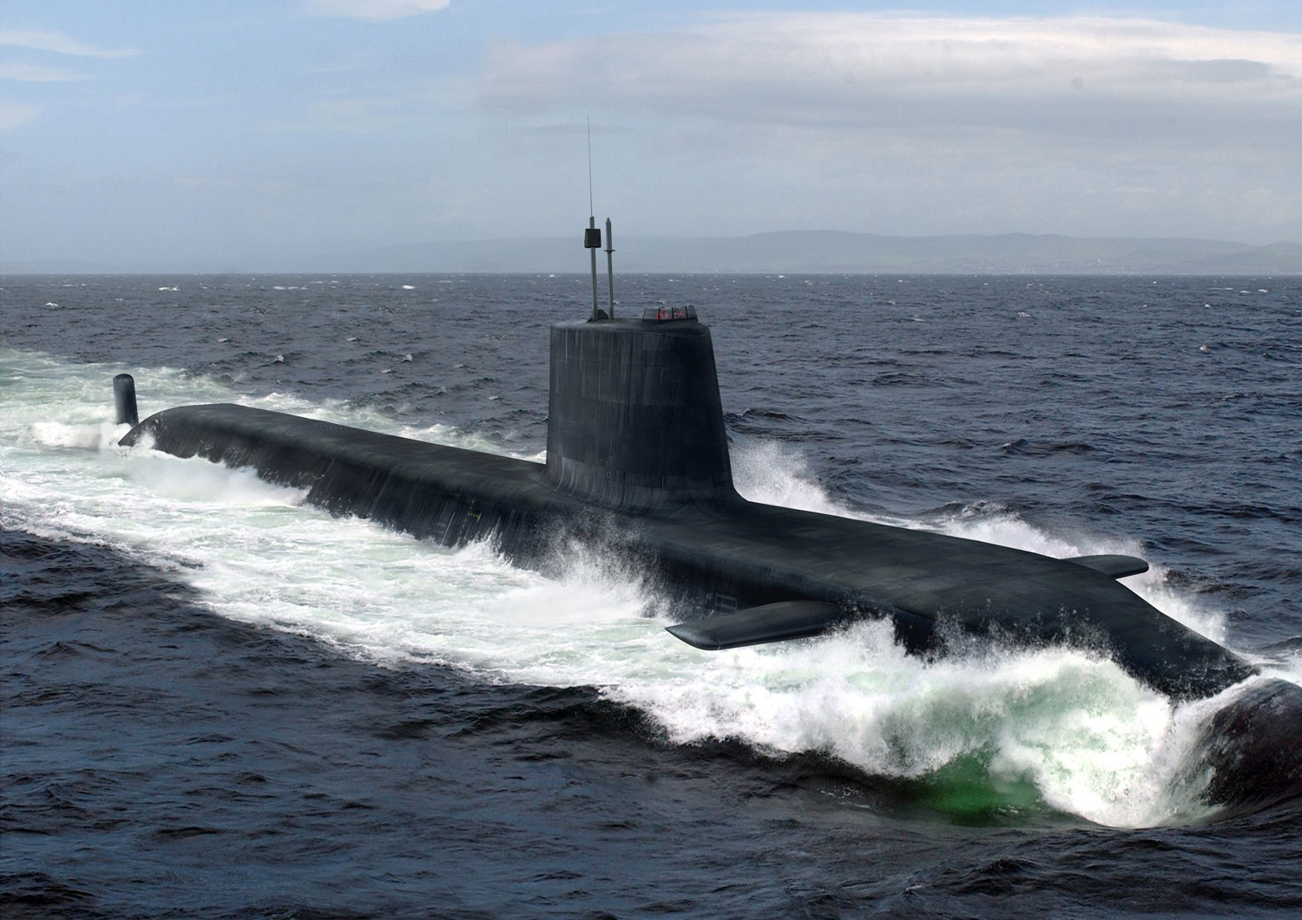
10-03 Sound
Sonar (Sound Navigation Ranging)
Sound is emitted from the hull of a ship.
It bounces off some object.
The echo returns to a receiver on the hull of the ship
How far away is a ship if it takes 3.4 s to receive a return signal in seawater?
d = 2618 m
Notes:
$$v=1540 m/s$$
$$x=vt→x=\left(1540\frac{m}{s}\right)\left(3.4 s\right)→x=5236 m$$
This the distance to the object and back again. So divide it by 2 → $x=2618 m$

Slide 40
10-03 Homework
Speed your way through these sound problems.
Read
OpenStax College Physics 2e 17.3
OR
OpenStax High School Physics 14.1, 2

Slide 41
10-04 Intensity
In this lesson you will…
Understand how human perceive the properties of sound waves.
Use the decibel scale.
Notes:
OpenStax High School Physics 14.1,2
OpenStax College Physics 2e 17.3

Slide 42
10-04 Intensity
Sound waves carry energy that can do work
Amount of energy transported per second = power
Units: J/s = W
Notes:
Work example causing ear drum to vibrate

Slide 43
10-04 Intensity
As sound moves away from a source, it spreads out over a larger and larger area
As the areas get bigger, intensity at any 1 point is less
$I=\frac{P}{A}$
Units: W/m²

Slide 44
10-04 Intensity

Slide 45
10-04 Intensity
Intensity is proportional to amplitude²
$$I=\frac{{\left(Δp\right)}^{2}}{2ρv_{w}}$$
where
$Δp$ = pressure amplitude
$ρ$ = density of the medium
$v_{w}$ = speed of the wave
Notes:
Used lowercase p for Pressure to keep from confusing with Power

Slide 46
10-04 Intensity
Sound Level and Decibels
Unit of measure to compare two sound intensities.
Based on how human ear perceives loudness.
If you double the intensity, I, the sound isn’t twice as loud.
Use a logarithmic scale

Slide 47
10-04 Intensity
Intensity Level
$$β=\left(10 dB\right)\log\left(\frac{I}{I_{0}}\right)$$
Where
β = intensity level β
I and I₀ are intensities of two sounds
I₀ is usually $1.0×{10}^{−12}$W/m²
Unit: dB (decibel)
An intensity level of zero only means that I = I₀ since log (1) = 0
Notes:
I₀ is the threshold of hearing

Slide 48
10-04 Intensity
Intensity can be measured
Loudness is simply how ear perceives
Doubling intensity does not double loudness

Slide 49
10-04 Intensity
You double the intensity of sound coming from a stereo. What is the change in loudness?
β = 3 dB
Experiment shows that if the intensity level increases by 10 dB, the sound will seem twice as loud.
See Table 17.2
Notes:
$$β=\left(10 dB\right)\log\left(\frac{I}{I_{0}}\right)$$
$$β=\left(10 dB\right)\log\left(\frac{2I}{I}\right)$$
$$β=\left(10 dB\right)\log{2}$$
$$β≈3 dB$$
Thus a 200 W stereo system will only sound twice as loud as a 20 W system.

Slide 50
10-04 Intensity
What is the intensity of a 20 dB sound?
$I={10}^{−10} W/m^{2}$
Notes:
$$β=\left(10 dB\right)\log\left(\frac{I}{I_{0}}\right)$$
$$20 db=\left(10 dB\right)\log\left(\frac{I}{{10}^{−12} W/m^{2}}\right)$$
$$2=\log\left(\frac{I}{{10}^{−12} W/m^{2}}\right)$$
$${10}^{2}=\frac{I}{{10}^{−12} W/m^{2}}$$
$$I={10}^{−10} W/m^{2}$$

Slide 51
10-04 Homework
This is intense!
Read
OpenStax College Physics 2e 17.4
OR
OpenStax High School Physics 14.3

Slide 52
10-05 Doppler Effect
In this lesson you will…
• Define Doppler effect, Doppler shift, and sonic boom.
• Calculate the frequency of a sound heard by someone observing Doppler shift.
Notes:
OpenStax High School Physics 14.3
OpenStax College Physics 2e 17.4

Slide 53
10-05 Lab
Do the 10-04 Doppler Effect Lab

Slide 54
10-05 Doppler Effect
Have you ever listened to a ambulance drive by quickly with their lights and sirens going?
What did it sound like?
High pitch as they were coming, low pitch as they were leaving.
Called Doppler effect after Christian Doppler who first labeled it.

Slide 55
10-05 Doppler Effect
Stationary source of sound
Moving source of sound
Notes:
When the truck is still, the sounds waves move outward in all the directions, the same speed

Slide 56
10-04 Doppler Effect
Notes:
When the truck is moving.
It produces a condensation, moves, produces another condensation, moves, etc.
Since it moves between condensations, they are closer together in front of the truck and farther apart behind the truck.
Higher freq (short λ) = higher pitch
Lower freq (long λ) = lower pitch

Slide 57
10-05 Doppler Effect
Deriving the formula
Moving toward object
$λ′=λ−v_{s}T$
Where
λ = wavelength of wave
λ’ = perceived wavelength
v_{s} = velocity of source
T = Period of wave
Notes:
The perceived wavelength is shorted by the distance the source moves in one period.
(Period is time between condensations)

Slide 58
10-05 Doppler Effect
$f_{o}=\frac{v_{w}}{λ^{′}}=\frac{v_{w}}{λ−v_{s}T}$
$λ=\frac{v_{w}}{f_{s}}$ $T=\frac{1}{f_{s}}$
$f_{o}=f_{s}\left(\frac{v_{w}}{v_{w}−v_{s}}\right)$
λ’ = perceived wavelength
f_{o} = frequency observed
f_{s} = frequency of source
v_{w} = speed of wave
v_{s} = speed of source

Slide 59
10-05 Doppler Effect
Moving Observer
Encounters more condensations than if standing still
$f_{o}=f_{s}\left(\frac{v_{w}+v_{o}}{v_{w}}\right)$
Notes:
Notice the differences between the two formulas

Slide 60
10-05 Doppler Effect
General Case
Combine the two formulas
Both observer and source can be moving
WARNING!
v_{w}, v_{s}, and v_{o} are signless
Use the top signs when that object is moving towards the other object
$f_{o}=f_{s}\left(\frac{v_{w}±v_{o}}{v_{w}∓v_{s}}\right)$

Slide 61
10-05 Doppler Effect
You are driving down the road at 20 m/s when you approach a car going the other direction at 15 m/s with their radio playing loudly. If you hear a certain note at 600 Hz, what is the original frequency? (Assume speed of sound is 343 m/s)
542 Hz
Notes:
$$f_{o}=f_{s}\left(\frac{v_{w}±v_{o}}{v_{w}∓v_{s}}\right)$$
$$600 Hz=f_{s}\left(\frac{343\frac{m}{s}+20\frac{m}{s}}{343\frac{m}{s}−15\frac{m}{s}}\right)$$
$$600 Hz=f_{s}\left(1.1\right)$$
$$f_{s}=542 Hz$$

Slide 62
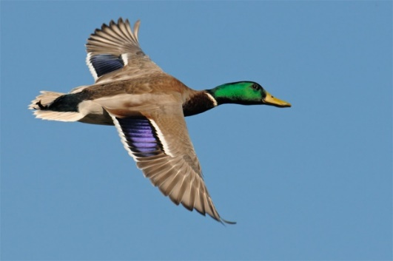
10-05 Doppler Effect
A duck is flying overhead while you stand still. As it moves away, you hear its quack at 190 Hz. Because you are a brilliant naturalist, you know that this type of duck quacks at 200 Hz. How fast is the duck flying?
18.1 m/s (40 mph)
Notes:
$$f_{o}=f_{s}\left(\frac{v_{w}±v_{o}}{v_{w}∓v_{s}}\right)$$
$$190 Hz=200 Hz\left(\frac{343\frac{m}{s}+0}{343\frac{m}{s}+v_{s}}\right)$$
$$65170 \frac{m}{s}+190 v_{s}=68600\frac{m}{s}$$
$$190 v_{s}=3430\frac{m}{s}$$
$$v_{s}=18.1\frac{m}{s}$$

Slide 63
10-05 Doppler Effect
Weather Radar
Sends out radio waves
Wave bounce off water drops in storms
Radar receives echoes
Computer checks to compare the frequencies
Can compute to see how fast the clouds are spinning
Notes:
Water on one side of tornado move away, water on other side move towards radar
See the triangle in the picture.

Slide 64
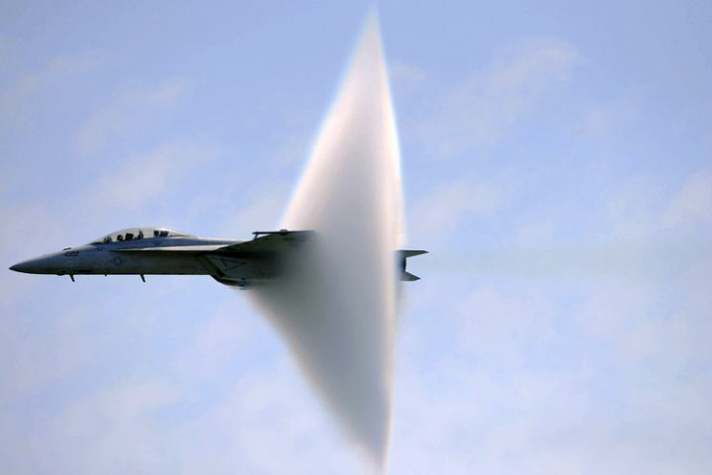
10-05 Doppler Effect
Sonic boom when the plane goes the speed of sound, so all the forward moving waves pile up in one spot.

Slide 65
10-05 Homework
Move yourselves to do these exercises
Read
OpenStax College Physics 2e 17.5
OR
OpenStax High School Physics 14.4

Slide 66
10-06 Resonance
In this lesson you will…
Define antinode, node, fundamental, overtones, and harmonics.
Describe how sound interference occurring inside open and closed tubes changes the characteristics of the sound, and how this applies to sounds produced by musical instruments.
Calculate the length of a tube using sound wave measurements.
Notes:
OpenStax High School Physics 14.4
OpenStax College Physics 2e 17.5

Slide 67
10-06 Resonance
One end of a string is attached to a fixed point.
The other end is vibrated up and down slightly.
The standing wave is formed.
Nodes – No move
Antinodes – most movement

Slide 68
10-06 Resonance
The wave travels along the string until it hits the other end
The wave reflects off the other end and travels in the opposite direction, but upside down
The returning wave hits the vibrating end and reflects again (this side the wave is right side up)
Unless the timing is just right the reflecting wave and the new wave will not coincide
When they do coincide, the waves add due to constructive interference
When they don’t coincide; destructive interference
Notes:
Why its reflected upside down. → the string pulls up on the wall, by Newton’s reaction force, the wall pulls down on the string

Slide 70
10-06 Resonance
Harmonics
When you vibrate the string faster, you can get standing waves with more nodes and antinodes
Standing waves are named by number of antinodes
1 antinode → 1st harmonic (fundamental freq)
2 antinodes → 2nd harmonic (1st overtone)
3 antinodes → 3rd harmonic (2nd overtone)

Slide 71
10-06 Resonance
f₁ = fundamental frequency (1st harmonic)
f₂ = 2f₁ (2nd harmonic)
f₃ = 3f₁ (3rd harmonic)
Harmonics Example
If the fundamental is 440 Hz (concert A)
2nd harmonic = 2(440 Hz) = 880 Hz (High A)
3rd harmonic = 3(440 Hz) = 1320 Hz
Notes:
Multiply the fundamental frequency by an integer to obtain that integer’s harmonic

Slide 72
10-06 Resonance
To find the fundamental frequencies and harmonics of a string fixed at both ends
$$f_{n}=n\left(\frac{v_{w}}{2L}\right)$$
Where
f_{n} = frequency of the n^{th} harmonic
n = integer (harmonic #)
v_{w} = speed of wave
L = length of string

Slide 73
10-06 Resonance
Just like stringed instruments rely on standing transverse waves on strings
Wind instruments rely on standing longitudinal sound waves in tubes
The waves reflect off the open ends of tubes
One difference at the ends are antinodes instead of nodes
Notes:
Demonstrate antinodes at the end by making standing waves in a string by dangling a string and shaking it

Slide 74
10-06 Resonance
Tube open at both ends

Slide 75
10-06 Resonance
Formula for Tube Open at Both Ends
Distance between antinodes = ½ λ
Tube must be integer number of ½ λ
$L=n\left(\frac{1}{2}λn\right)$ or $n=\frac{2L}{n}$
$fn=\frac{v_{w}}{λn}$
$$f_{n}=n\left(\frac{v_{w}}{2L}\right)$$
Notes:
Demonstrate with tube

Slide 76
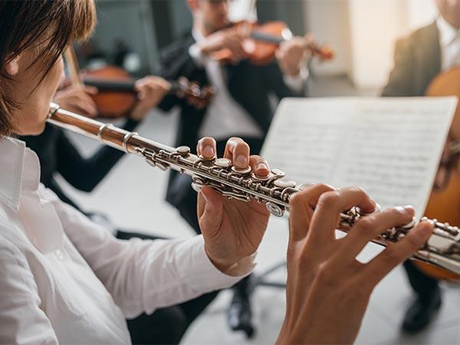
10-06 Resonance
What is the lowest frequency playable by a flute that is 0.60 m long if that air is 20 °C.
f = 285.8 Hz
Notes:
$$n = 1$$
$$f = 1\left(\frac{343\frac{m}{s}}{2\left(.6 m\right)}\right) = 285.8 Hz$$

Slide 77
10-06 Resonance
Tube open at one end

Slide 78
10-06 Resonance
Tube Open at One End
Node at the closed end
Antinode at the open end
At fundamental frequency L = ¼ λ
The 2nd harmonic adds one more node or ½ λ
Thus the lengths are odd integer multiples of ¼ λ
$$f_{n}=n\left(\frac{v_{w}}{4L}\right)$$
Only odd harmonics
Notes:
Where n is odd integers

Slide 79
10-06 Homework
Try blowing your way through these problems

